Slide 1
3-D Vocabulary 1st 9 weeks

Slide 2
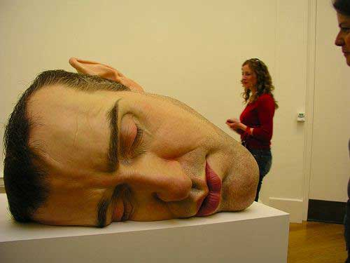
Sculpture

Slide 3
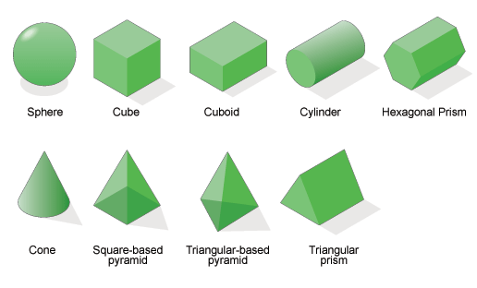
Dimension & Forms

Slide 4
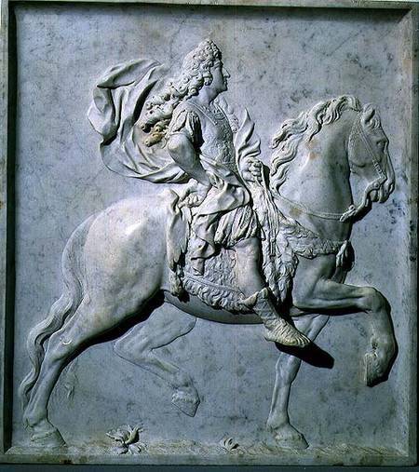
Sculpture in the Round Relief Sculpture

Slide 5
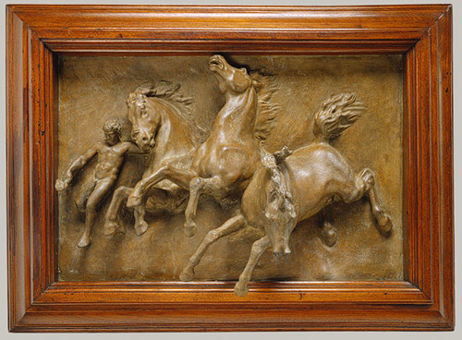
Bas Relief & High Relief

Slide 6
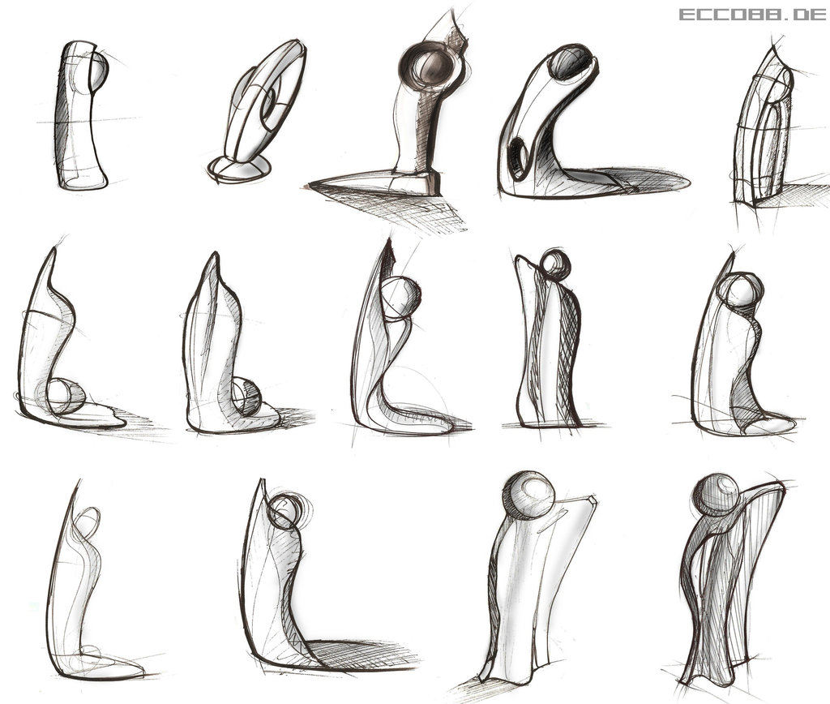
Thumbnail Sketches & Maquettes

Slide 7
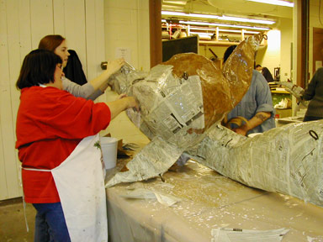
Additive & Subtractive

Slide 8
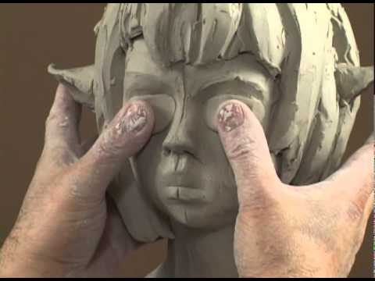
Modeling & Carving

Slide 9
Casting & Plaster

Slide 10
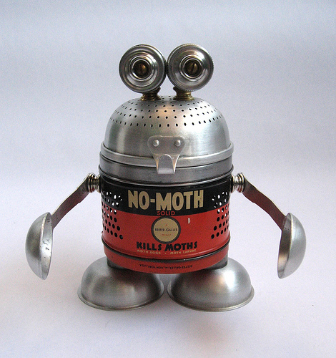
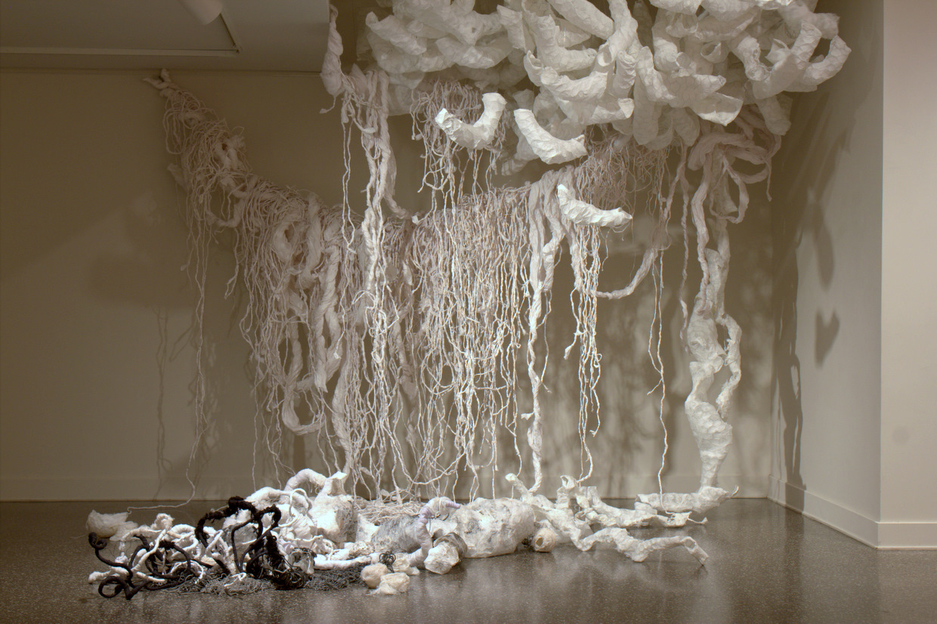
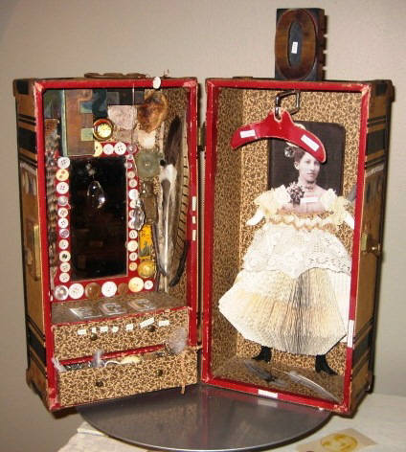
Assemblage & Installation

Slide 11
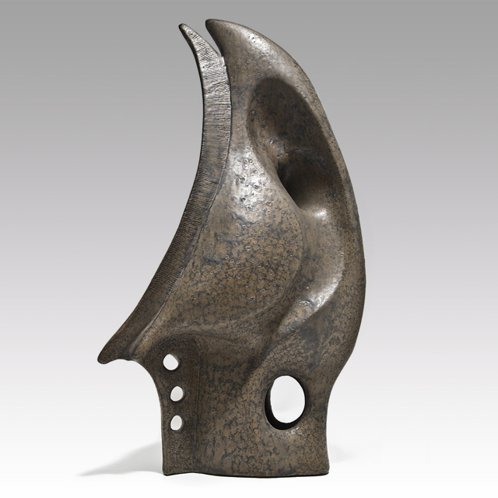
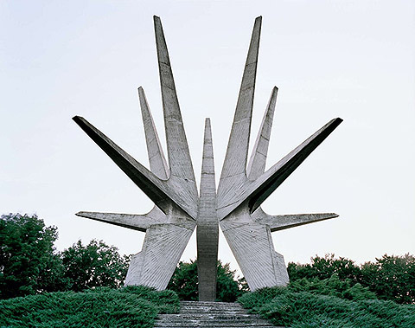
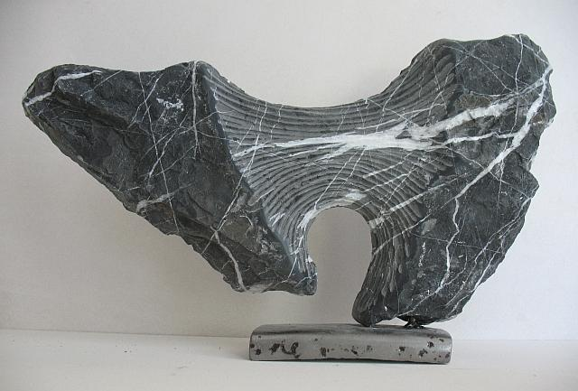
Asymmetrical, Void, Tension

