Slide 1
Creativity
Notes:
Sometimes a scary word. Am a creative? Some people say they are.. Is that true?
We started off the year by talking about creativity last school year, and I really noticed a difference in how students thought about their art all year long. Something clicked.
Something worked… we got 26 Scholastic art awards!

Slide 2
Article: “As Children’s Freedom Has Declined, So Has Their Creativity”
New research suggests that American schoolchildren are becoming less creative.
Did testing on Creative Thinking over several decades, starting in the ‘80s.
Notes:
I want to start with this article I read. I was looking for some more information about Creativity.
Psychologytoday.com

Slide 3
“Children have become
less emotionally expressive,
less energetic,
less talkative and verbally expressive,
less humorous,
less imaginative,
less unconventional,
less lively and passionate, less perceptive,
less apt to connect seemingly irrelevant things,
less synthesizing, and
less likely to see things from a different angle.”

Slide 4
Notes:
You are as boring as a kumquat

Slide 5
“In the real world few questions have one right answer, few problems have one right solution; that’s why creativity is crucial to success in the real world.”
Notes:
This made me realize, man, I really need to talk about creativity again. You don’t get this in other classes.
Not all of you will have art careers, but you will do something important.

Slide 6
What is the
Process of Creating Art?
First:
What do you do when you create a work of art? Talk through it.
Second:
Divide into Key Steps
Third:
Give each step a key word(s)

Slide 7
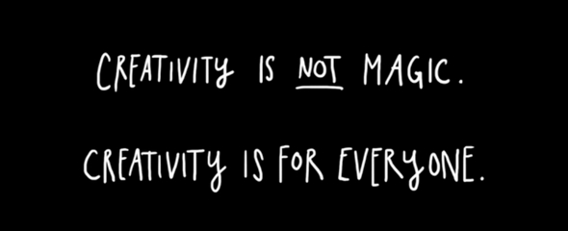

Slide 8
My ultimate real world goal:
You need quality work and EXPERIENCES to create an art portfolio.
You may choose to use this for a career in art or you may not but that is where EXPERIENCES and creativity are important.
Notes:
I want you to find the spark in each project. My job is to give you project framework and I craft it for you. Most students don’t think about what I do, but I craft lessons for you to succeed. I design them while literally imagining you guys doing the project.
BIG POINT: What some students might question at times is why can’t I do whatever I want? I also believe one of the most important parts of my job is to steer you away from ideas that are overdone and WORK WITH YOU to find the best idea and to craft that into something more refined that you thought it could be.

Slide 9
How much room for Creativity do we have?
School appropriate
Directions are meant to help you FOCUS
Use some new skills and some you already have
Some materials/imagery provided, some are not
Help you find the BEST idea and steer you away from the worst.
Set of requirements can be tweaked “for the good of the artwork”

Slide 10
So what are we doing?
You will choose an image of anatomy
and COMBINE with with nature imagery.
You may also have the option of including an object.
Good to know:
Not everything has to make sense… make the viewer wonder.

Slide 11
How?
How can I come up with new ideas out of the blue without having seen them somewhere?
How do you find different objects and put them together to make a unique project?
How can I just look at things and try to combine them or differ them?

Slide 12
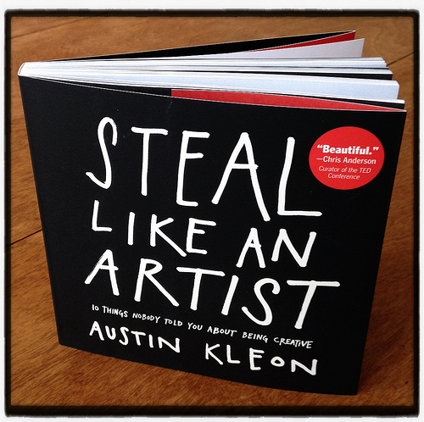
Notes:
Every artist gets asked the question, “Where do you get your ideas?” The honest artist answers, “I steal them.” How does an artist look at the world? First, you figure out what’s worth stealing, then you move on to the next thing. That’s about all there is to it. When you look at the world this way, you stop worrying about what’s “good” and what’s “bad”—there’s only stuff worth stealing, and stuff that’s not worth stealing. Everything is up for grabs. If you don’t find something worth stealing today, you might find it worth stealing tomorrow or a month or a year from now.

Slide 13
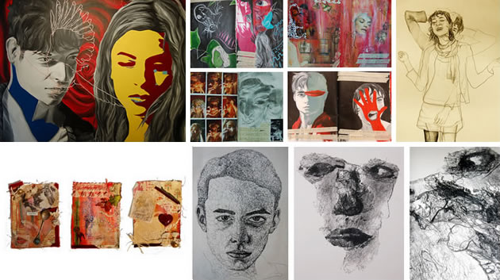
Originality

Slide 14
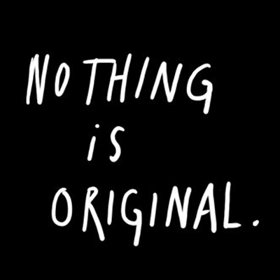
Notes:
The writer Jonathan Lethem has said that when people call something “original,” nine out of ten times they just don’t know the references or the original sources involved. What a good artist understands is that nothing comes from nowhere. All creative work builds on what came before. Nothing is completely original.

Slide 15
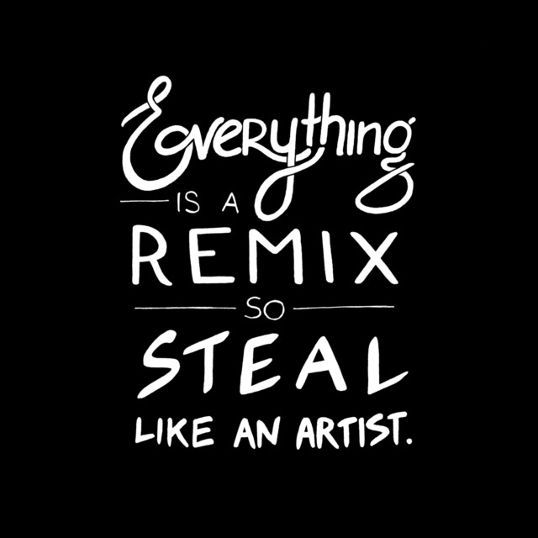
Notes:
Every new idea is just a mashup or a remix of one or more previous ideas.

Slide 16
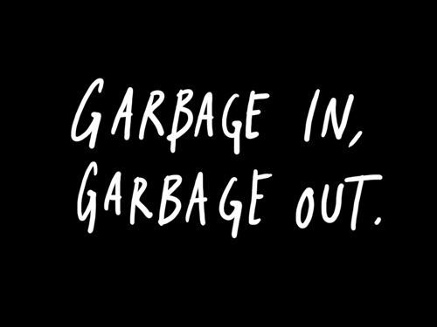
Notes:
The artist is a collector. Not a hoarder, mind you, there’s a difference: Hoarders collect indiscriminately, artists collect selectively. They only collect things that they really love. There’s an economic theory out there that if you take the incomes of your five closest friends and average them, the resulting number will be pretty close to your own income. I think the same thing is true of our idea incomes. You’re only going to be as good as the stuff you surround yourself with. My mom used to say to me, “Garbage in, garbage out.” It used to drive me nuts. But now I know what she meant. Your job is to collect good ideas. The more good ideas you collect, the more you can choose from to be influenced by.

Slide 17
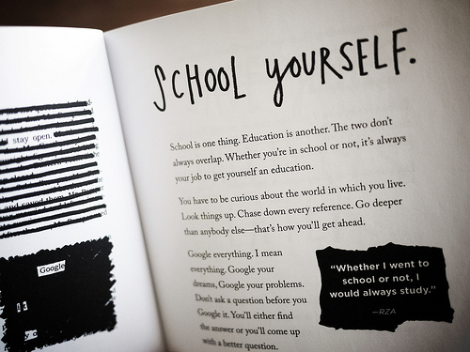
Notes:
School is one thing. Education is another. The two don’t always overlap. Whether you’re in school or not, it’s always your job to get yourself an education. You have to be curious about the world in which you live. Look things up. Chase down every reference. Go deeper than anybody else—that’s how you’ll get ahead. Google everything. I mean everything. Google your dreams, Google your problems. Don’t ask a question before you Google it. You’ll either find the answer or you’ll come up with a better question. Always be reading. Go to the library. There’s magic in being surrounded by books. Get lost in the stacks. Read bibliographies. It’s not the book you start with, it’s the book that book leads you to. Collect books, even if you don’t plan on reading them right away.

Slide 18
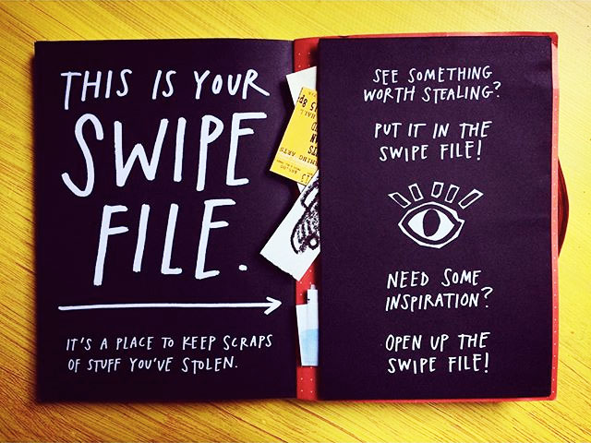
Notes:
Keep a swipe file. It’s just what it sounds like—a file to keep track of the stuff you’ve swiped from others. It can be digital or analog—it doesn’t matter what form it takes, as long as it works. You can keep a scrapbook and cut and paste things into it, or you can just take pictures of things with your camera phone. See something worth stealing? Put it in the swipe file. Need a little inspiration? Open up the swipe file.

Slide 19
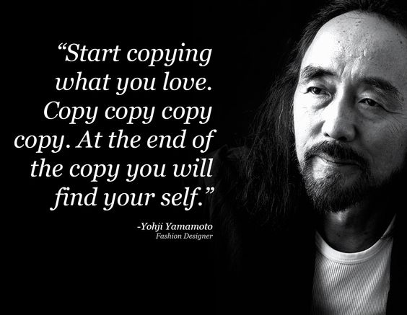
Notes:
“Start copying what you love. Copy copy copy copy. At the end of the copy you will find your self.” —Yohji Yamamoto
Nobody is born with a style or a voice. We don’t come out of the womb knowing who we are. In the beginning, we learn by pretending to be our heroes. We learn by copying. We’re talking about practice here, not plagiarism—plagiarism is trying to pass someone else’s work off as your own. Copying is about reverse-engineering. It’s like a mechanic taking apart a car to see how it works.
(Just like basic art and even drawing 1. You move on to copying styles in the higher levels of Drawing and Painting)

Slide 20
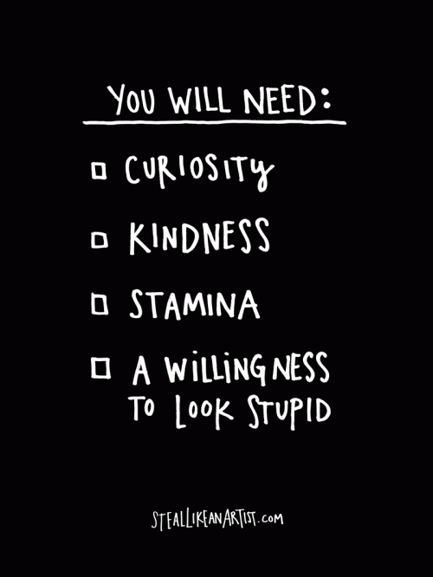
Notes:
Remember “garbage in, garbage out”? Your’e only going to be as good as the people you surround yourself with. In the digitial space, that means following the best people online—the people who are way smarter and better than you, the people who are doing the really interesting work. Pay attention to what they’re talking about, what they’re doing, what they’re linking to.

Slide 21
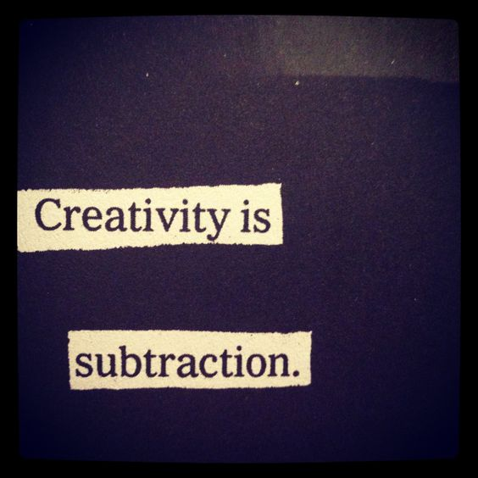
Notes:
In this age of information abundance and overload, those hwo get ahead will be the folks who figure out what to leave out, so they can concentrate on what’s really important to them. Nothing is more paralyzing than the idea of limitless possibilities. The idea that you can do anything is absolutely terrifying.
The way to get over creative block is to simply place some constraints on yourself. It seems contradictory, but when it comes to creative work, limitation mean freedom. Write a song on your lunch break. Paint a painting with only one color…. Build a machine out of spare parts. Don’t make excuses for not working--- make things with the time, space, and materials you have right now.
Did you know the Cat in the Hat uses only 236 words. Dr. Seuss’s editor bet him he couldn’t write a book with only 50 different words. He won the bet by writing Green Eggs and Ham.
It’s often what an artist chooses to leave out that makes the art interesting. What isn’t shown versus what is. It’s the same for people: What makes us interesting isn’t just what we’ve experience, but also what we haven’t experienced. The same is true when you do your work: You must embrace your limitations and keep moving. In the end, creativity isn’t jus the things we choose to put in, it’s the things we choose to leave out.
BACK TO THAT FRAMEWORK I TRY TO PROVIDE

