Slide 1
Drip Painting

Slide 2
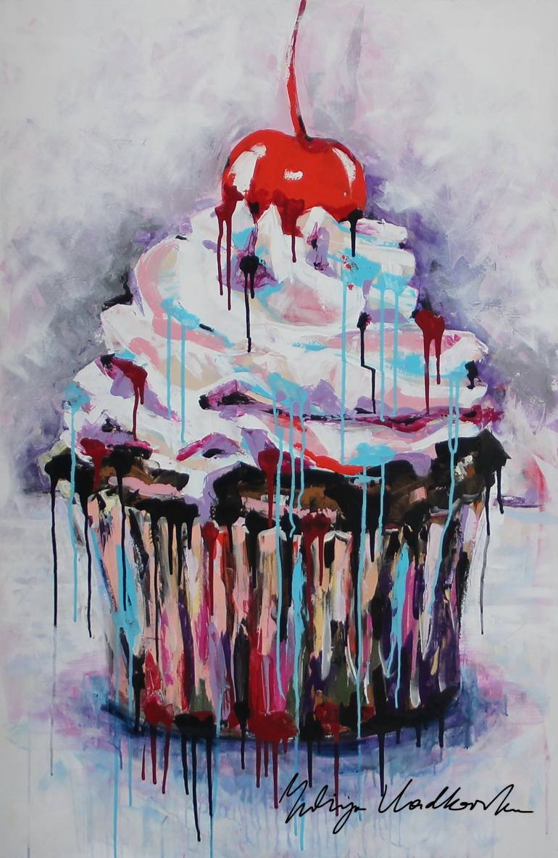
Yuliya Vladkovska

Slide 3
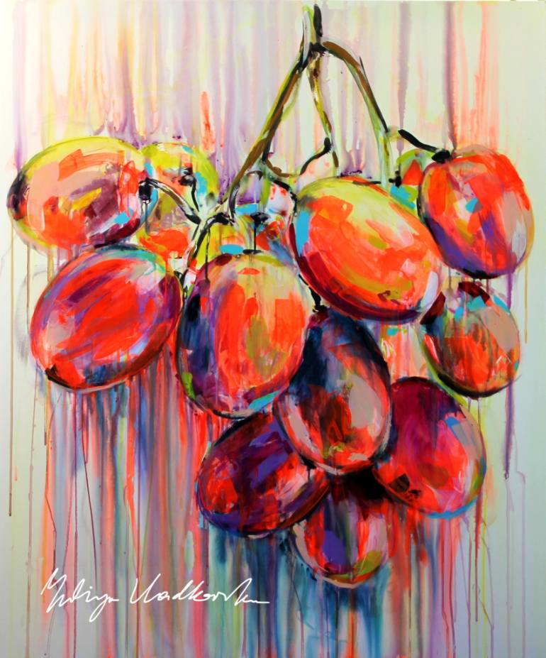
Yuliya Vladkovska

Slide 4
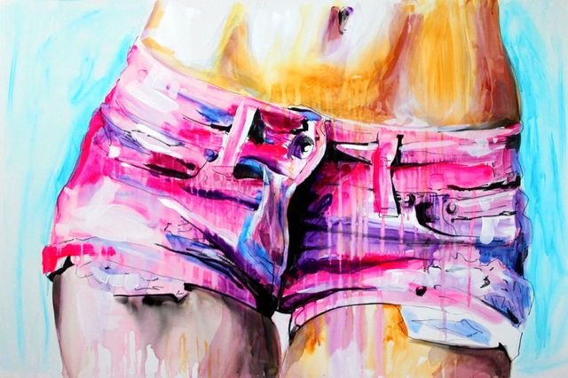
Yuliya Vladkovska

Slide 5
Subject matter:
Choose an object(s) that you feel will give the piece content. Be sure your image/ symbols are clear enough to be understood by the viewer when painted with drips.

Slide 6
1. Photograph your object(s) in an asymmetrical composition and consider how much space they will take up on the 18 x 24 canvas.
2. Use Adobe Color website to choose a Triad or Split Complementary (Compound). You will focus on this combination plus you can use black (you mix) and white.
*****You will need to mix a sample strip of all of your chosen colors

Slide 7
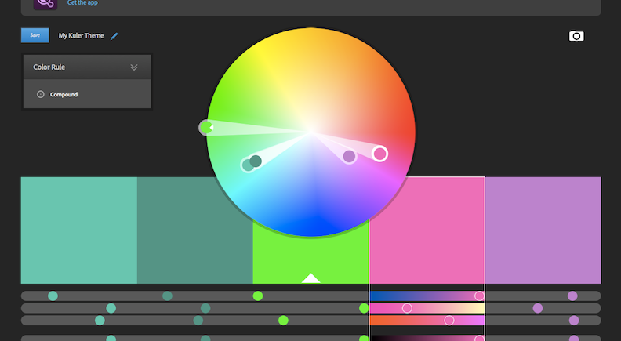
https://color.adobe.com/

Slide 8
Paint your canvas with a base coat of one or two of your colors (let dry)
Add another one of your colors overtop and spray with spray bottle to get drips (let dry)
Edit your image to have very high contrast and print. Consider negative space or areas that are less busy as the drip technique will fill some space. Print to 3 x 4.
Use this to sketch it onto your 18 x 24 canvas
Block in your darkest darks and then choose a few colors from your color combination to lay down as a base on your object. Start showing values with the colors.
Drip, drip! Build up interest with drips. Keep drips going consistently in one direction unless you have some particular reasoning behind the direction of your drips that adds content.

Slide 9
Drip Painting
https://www.youtube.com/watch?v=XjdgOjUowio

