Slide 1
Elisa Ancori b. 1990
Graduated in Fine Arts at the University of Barcelona, specialized in drawing and painting. His works revolve around the connection of nature with man. A fusion of body and soul which is scanned by a strong line in all his work. A continuous search for that balance, that unceasingly gives rise in every corner of nature.

Slide 3
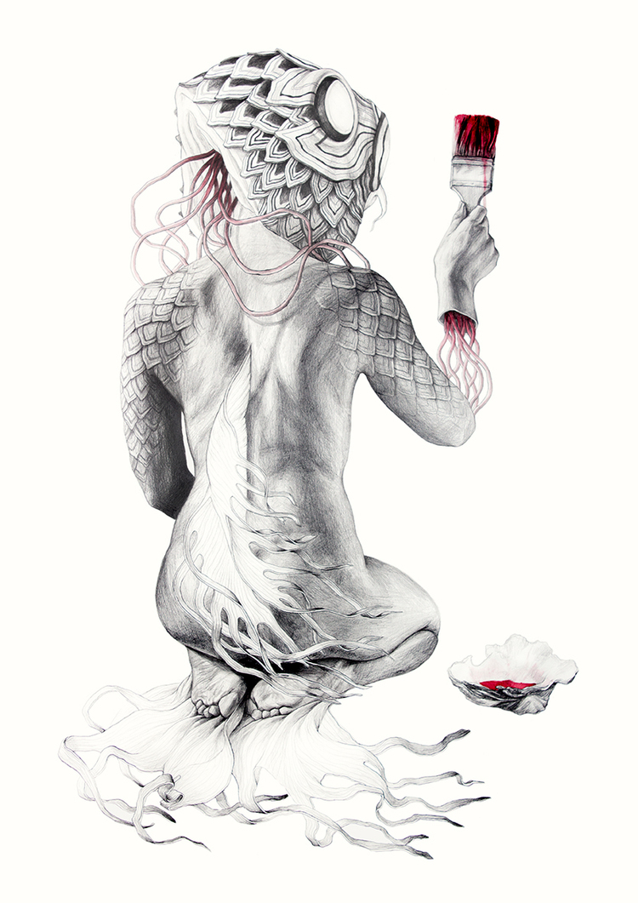

Slide 5
