Slide 1
Nature Inspired Portrait

Slide 4
Ideas
Layout or composition/ negative space
Integrating the natural elements into portrait (creating a relationship between the two)
Poses/ emotions
Other objects
Shaded/ non-shaded areas
1 painted area

Slide 10
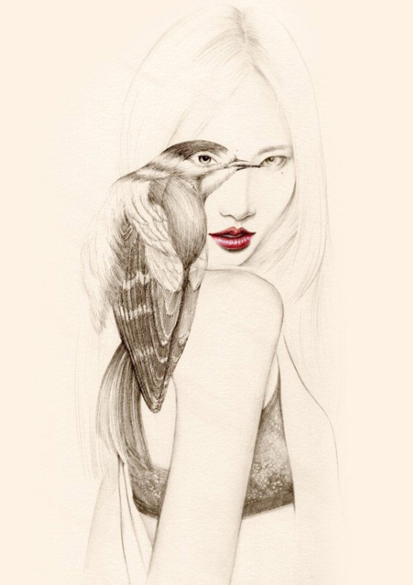

Slide 17
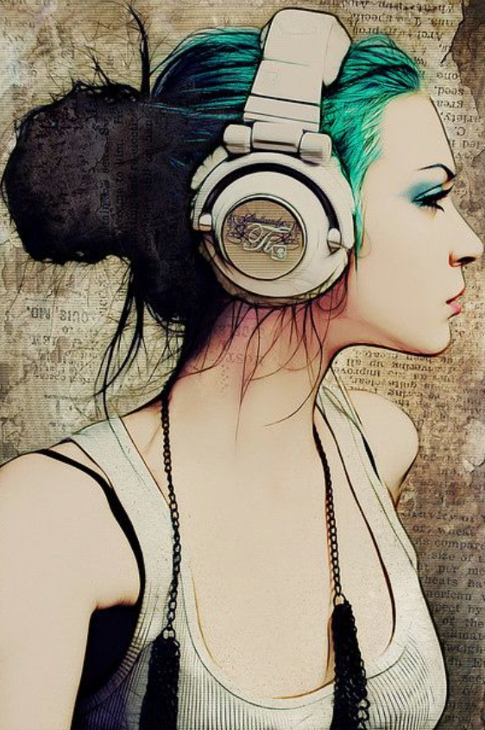

Slide 22
Well planned asymmetrical composition (with attention to negative space)
Fully shaded face with possible partially shaded body
3 or more natural elements
At least 1 painted shape that works in harmony with the rest of the piece

