Slide 1
Nature Mask

Slide 2
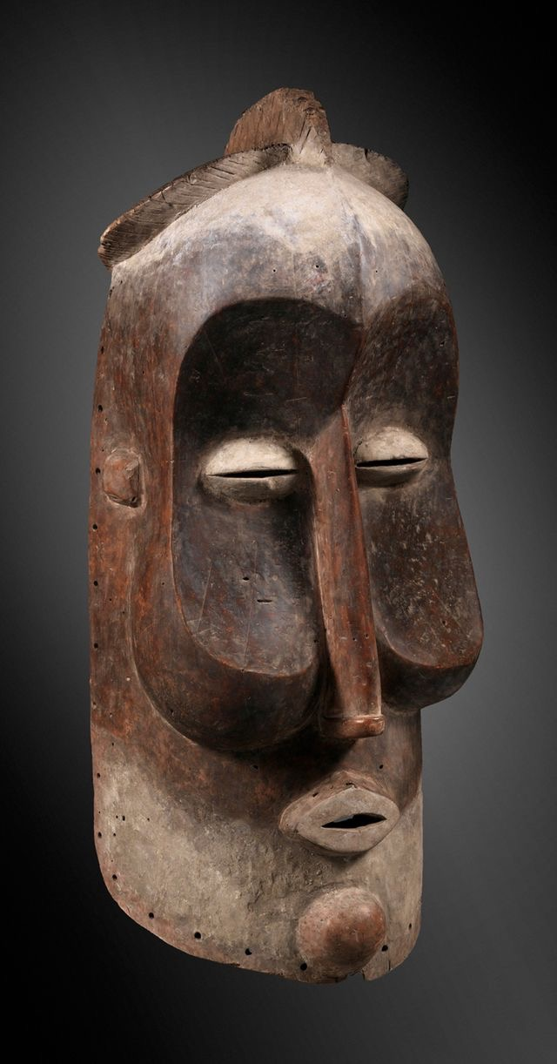
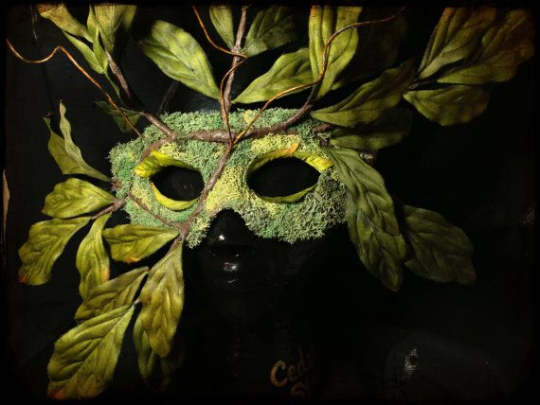
African Mask Forms
Nature Textures
Symmetrical Balance

Slide 3
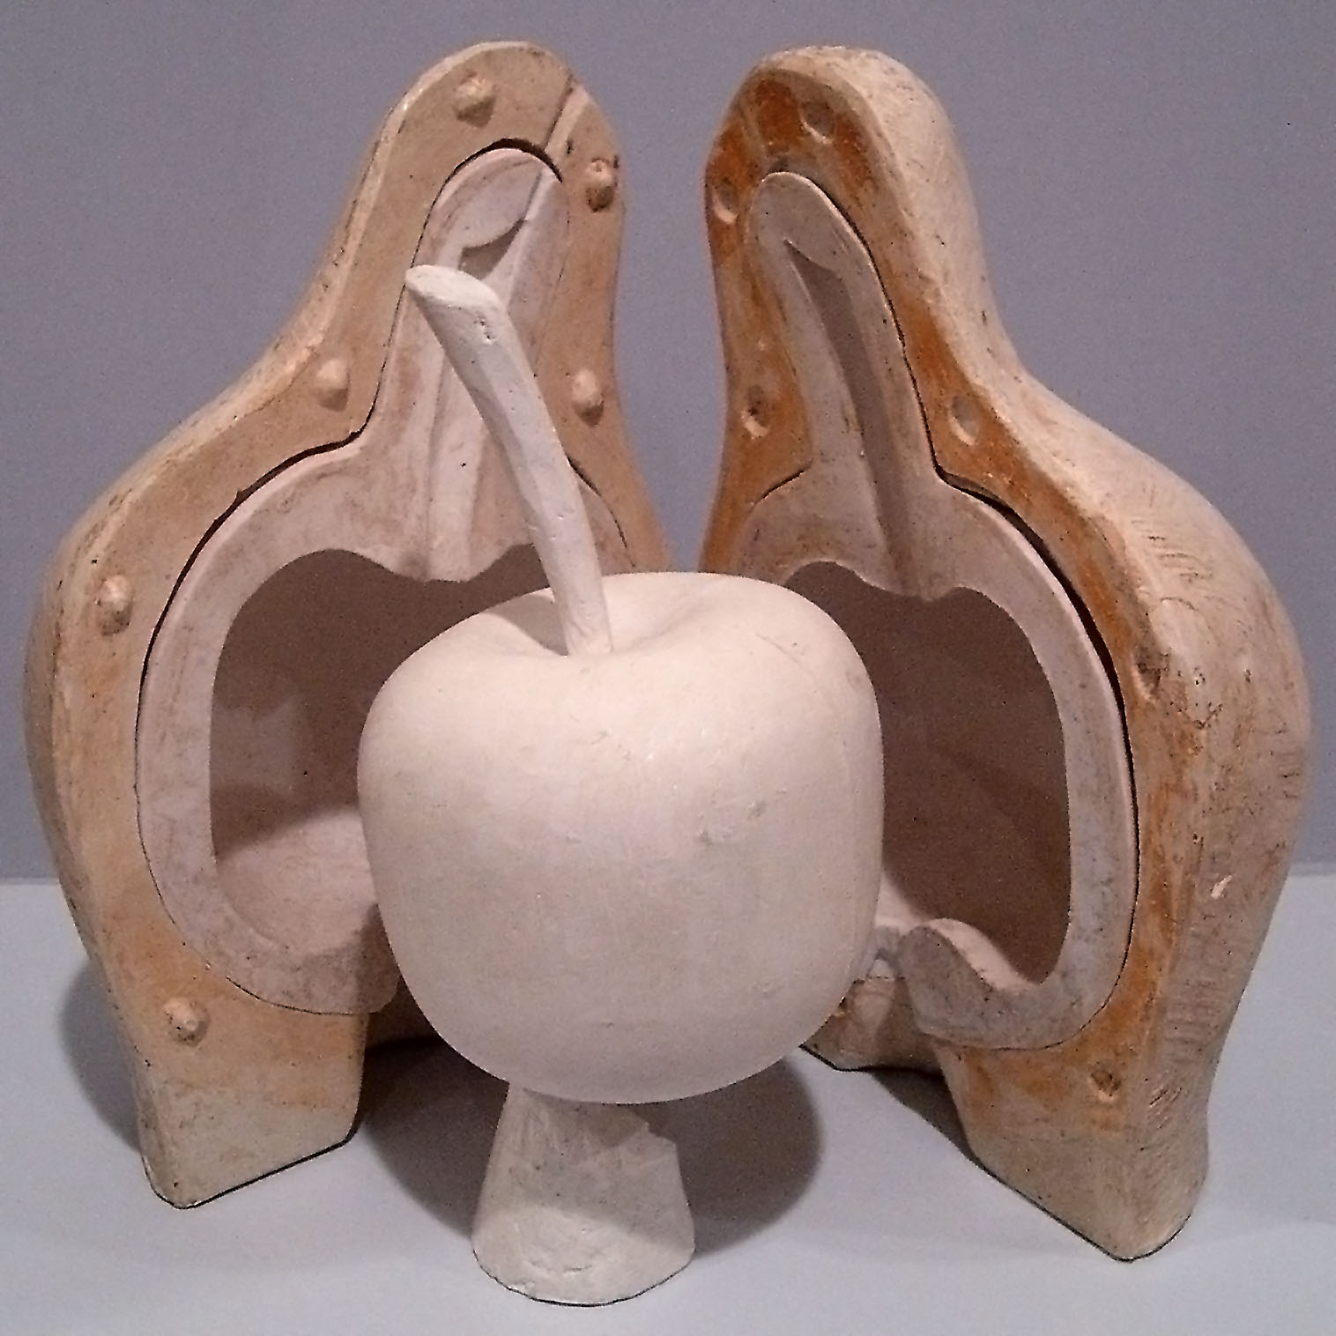
Casting using a Mold

Slide 4
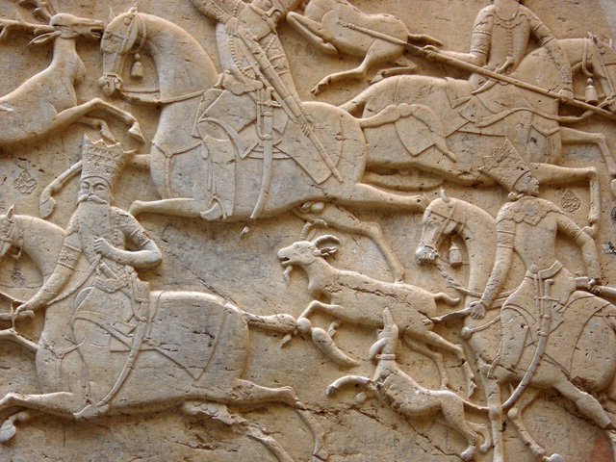
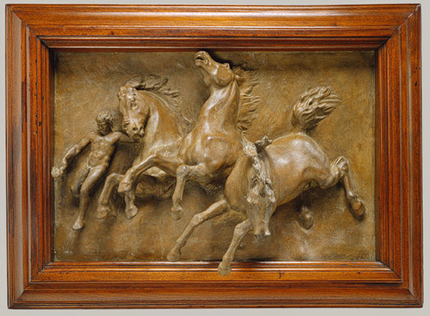
Bas Relief & High Relief

Slide 5
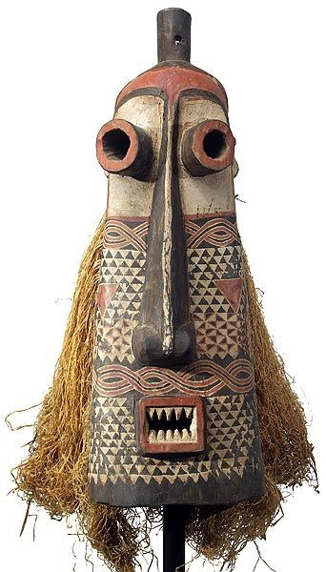
Symmetrical Balance

