Slide 1
Surreal Instrument Figure

Slide 2
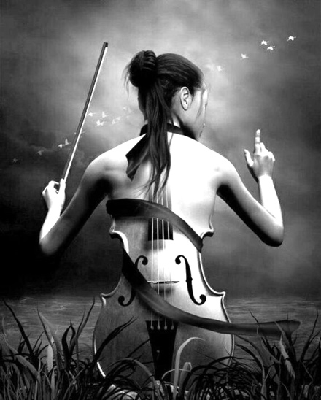
Requirements:
In this assignment, you will create a Surreal Instrument Figure that includes the following:
Well planned asymmetrical composition (with attention to negative space)
Instrument combined with human figure
At least 1 painted shape that works in harmony with the rest of the piece

Slide 3
Create at least 2 rough thumbnail drawings of your initial ideas while observing or photographing instruments. Researching Instrument shapes will help spur ideas!
Take figure photos. Take instrument photos. Print a 5 x 7 of figure and sketch a more finalized thumbnail with your instrument elements. (Could do this by tracing the figure on a new 5 x 7 or sketching overtop of the photo itself)

Slide 4
Grid your 5 x 7 photo (1”). Grid your newsprint (4”) 20” x 28” Sketch the figure: fairly detailed but no shading.
Alter with instrument elements: fairly detailed but no shading.
When drawing is complete, use graphite to transfer it to the final paper (Fix and finalize the drawing on the final paper, be sure edges are correct)
Paint the painted shape(s)
Render drawing with 9XXB pencil.

Slide 5
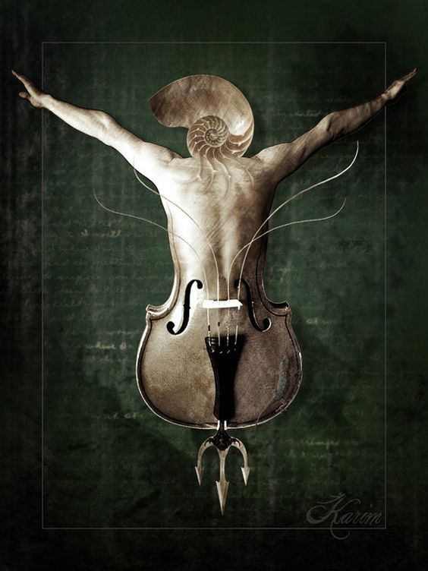

Slide 6
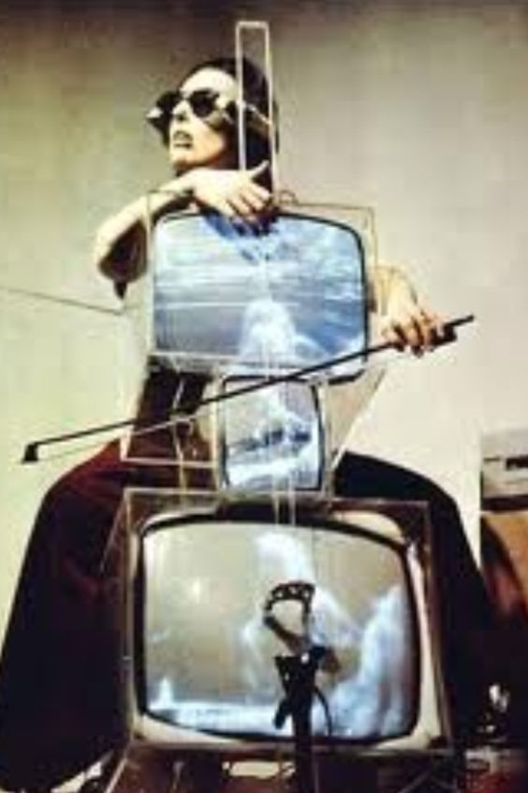
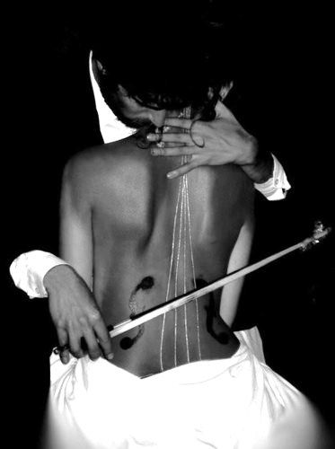

Slide 7
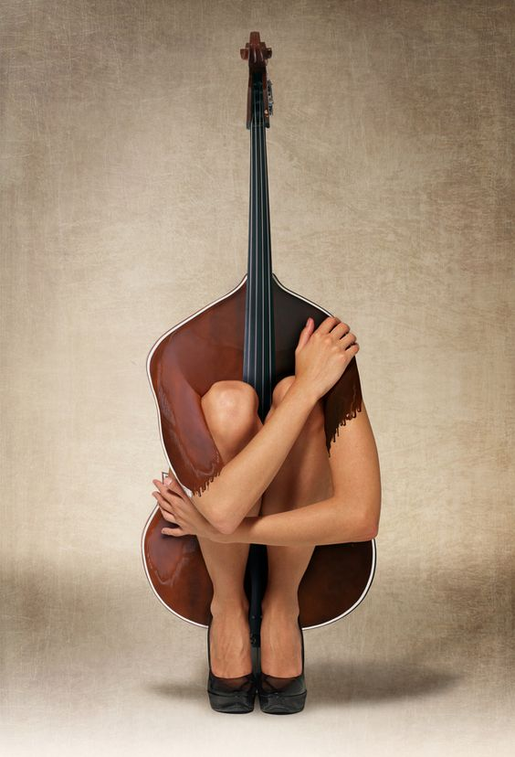

Slide 8
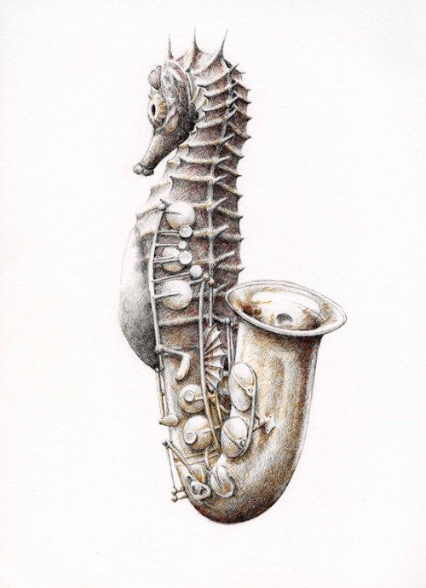
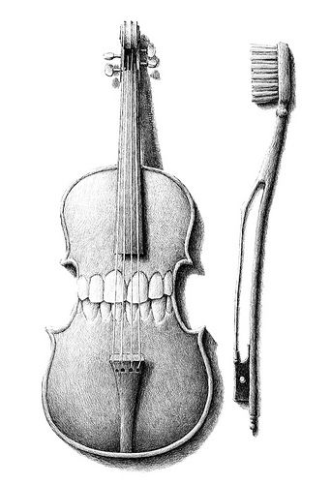
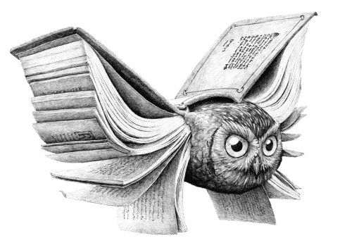

Slide 9
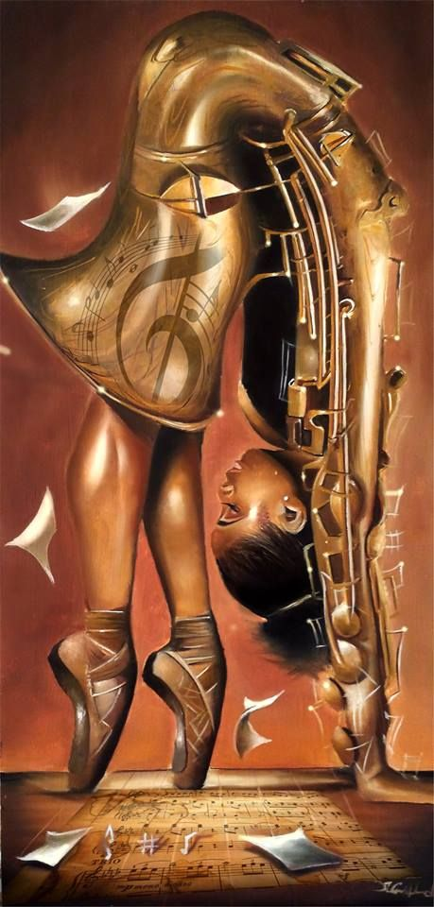
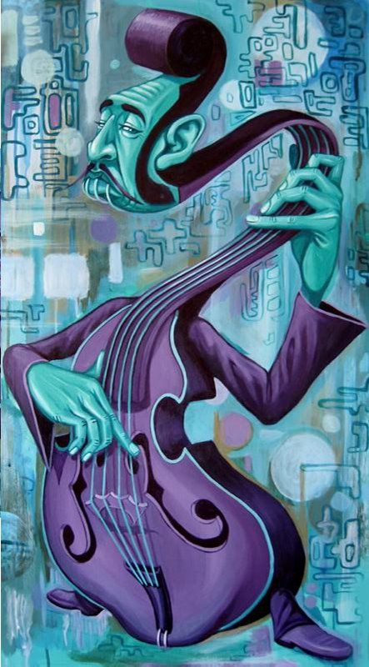

Slide 10
